Slide 1
Digital portfolio
Name: menakaran s
Register number and nmid:5A0C6B87E20BCA98E0C4804D5DED3577
Department: information technology
College: government arts and science college Gudalur Bharathiyar University

Slide 2

Project title
Menakaran portfolio

Slide 3

Agenda
Problem Statement
Project Overview
End Users
Tools and Technologies
Portfolio Design and Layout
Features and Functionality
Results and Screenshots
Conclusion

Slide 4
Problem statement
Clearly define the issue or gap your project aims to address
Describe the challenges or pain points faced by users.
Why this problem is significant and worth solving.
Example
“Many freelancers lack an easy way to showcase their skills and projects, making it harder for them to attract clients.”

Slide 5
Project Overview
Provide a concise summary of your project
Describe what your project is and its main purpose
Give an overview of its scope (what it covers and doesn’t cover)
Highlight the core idea behind your work.

Slide 6
End users
Identify the intended audience or users.
Who will benefit from this project?
How will they use it?
Example:
Students, freelancers, recruiters, developers, etc.

Slide 7
Tools and technologies
List and briefly describe the tech stack used Frontend: HTML, CSS, JavaScript, React, etc. Backend: Node.js, Django, Flask, etc. Databases: MySQL, MongoDB, etc. Others: APIs, libraries, or frameworks. Mention why you chose these tools.

Slide 8
Portfolio design And layout
Explain how you designed your portfolio. Structure: Sections (About Me, Projects, Skills, Contact). Aesthetic choices: Colours, fonts, UI elements. Layout style: Grid, single-page application, or multipage. Responsive design and user experience focus.

Slide 9
Features and functionality
List key features that make your project unique. Example:
User authentication system. Dark mode toggle. Downloadable resume. Interactive project showcase Contact form with email integration

Slide 10
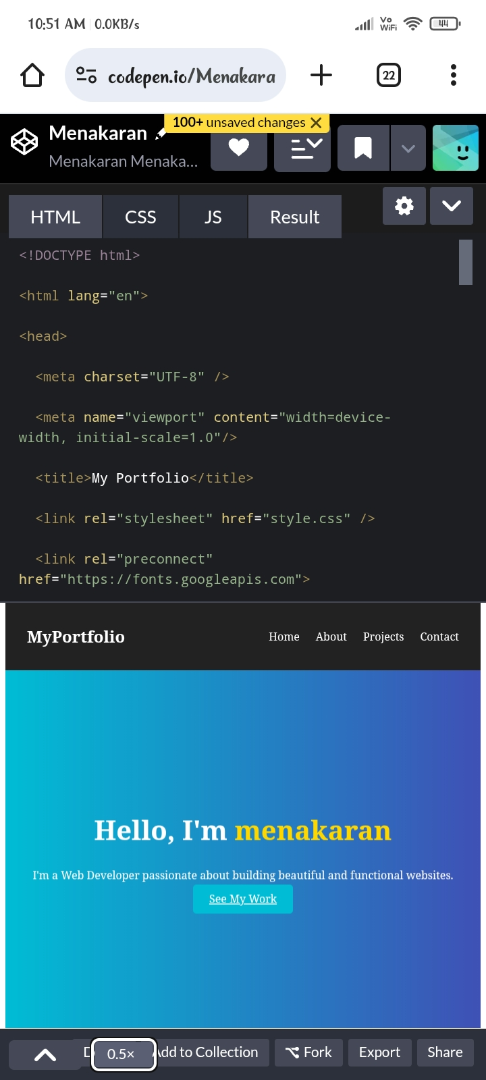
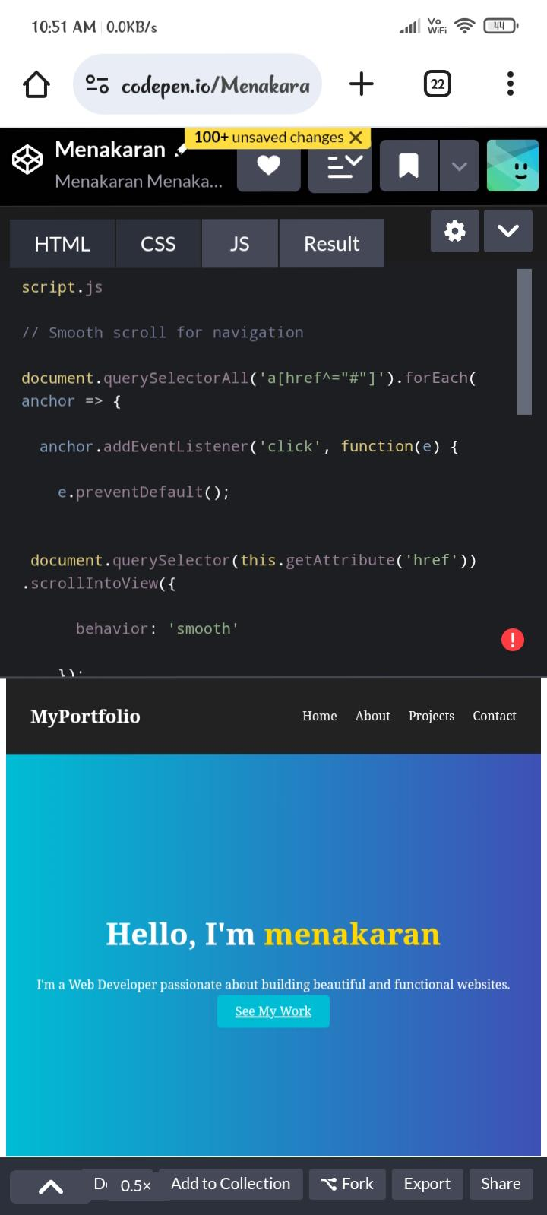
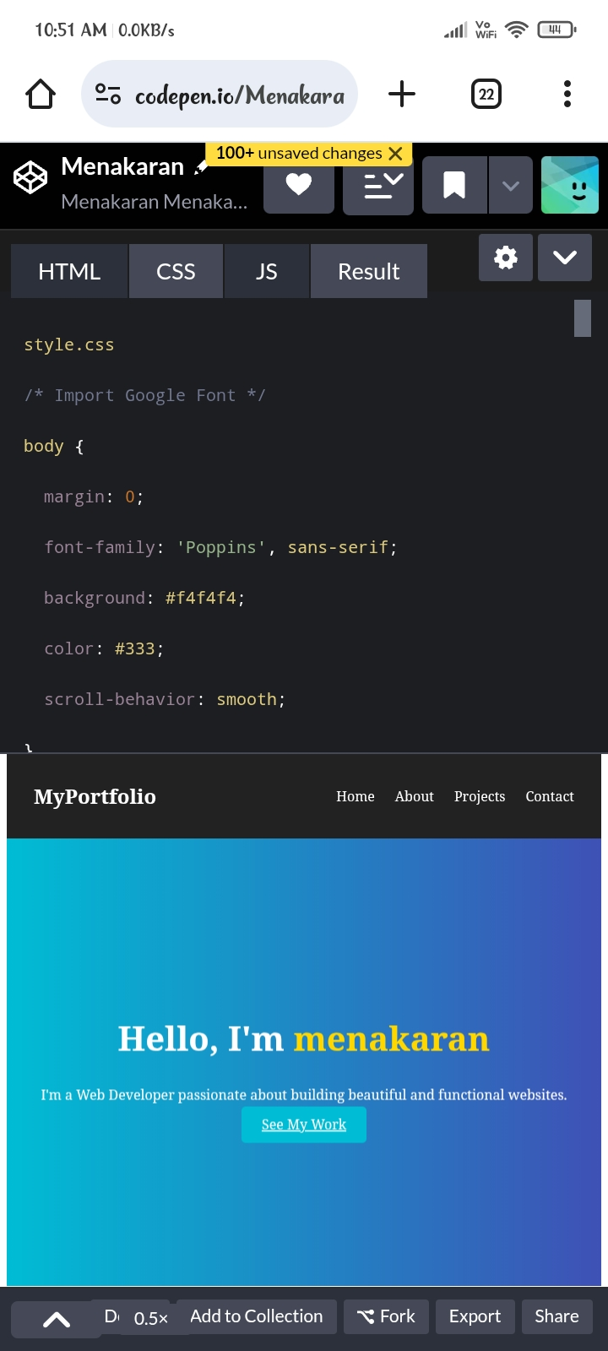
Results and screenshot

Slide 11
Conclusion
Summarize the value of your project. State how it solves the identified problem. Reflect on your learning experience. Suggest future enhancements or scalability options.

